Slide 1
Group 3 EzGo Application Prototype
Cheryl Cheong Kah Voon
Evelyn Goh Yuan Qi
Joanne Ching Yin Xuan
Lim Yu Han
Lam Yoke Yu

Slide 2
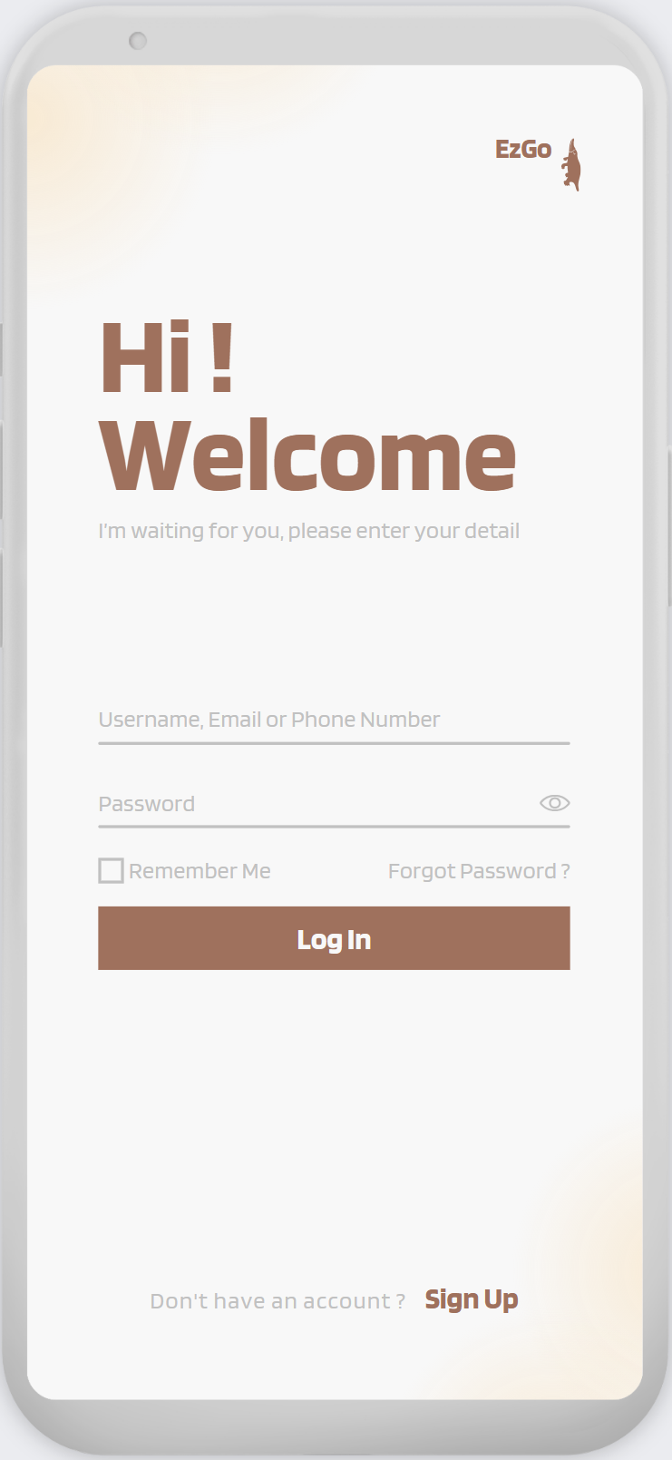
Log in
End Demo

Slide 3
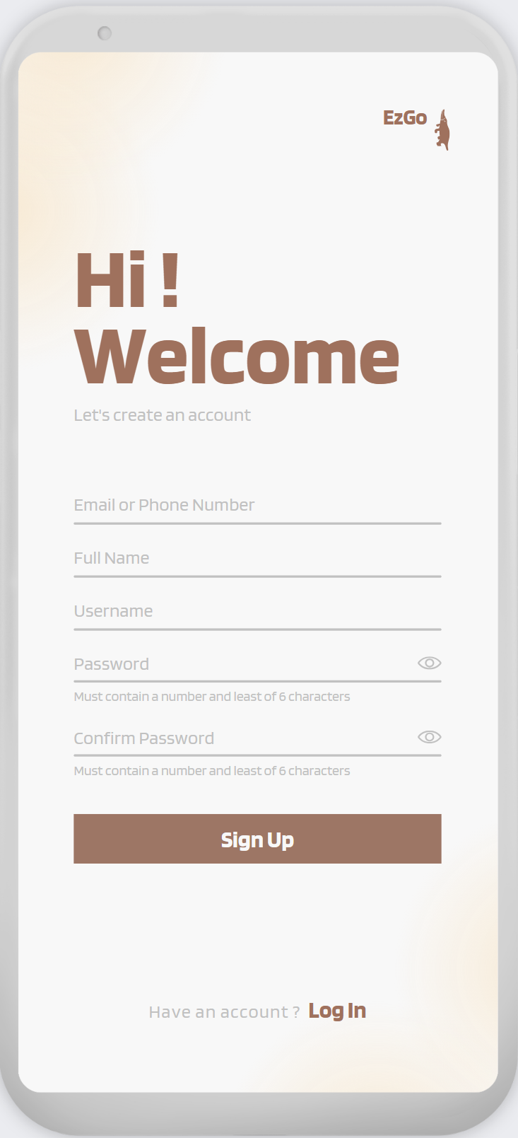
Sign Up
End Demo

Slide 4
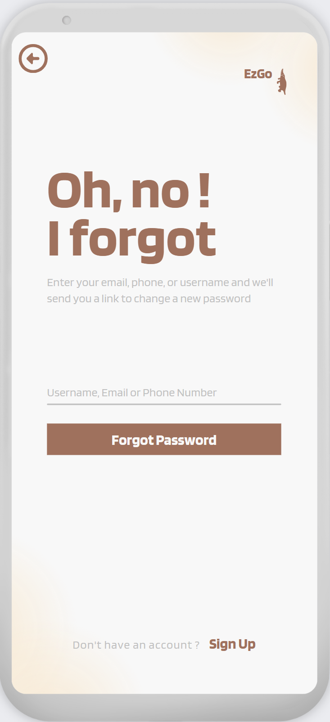
Forgot
password
End Demo
Log in

Slide 5
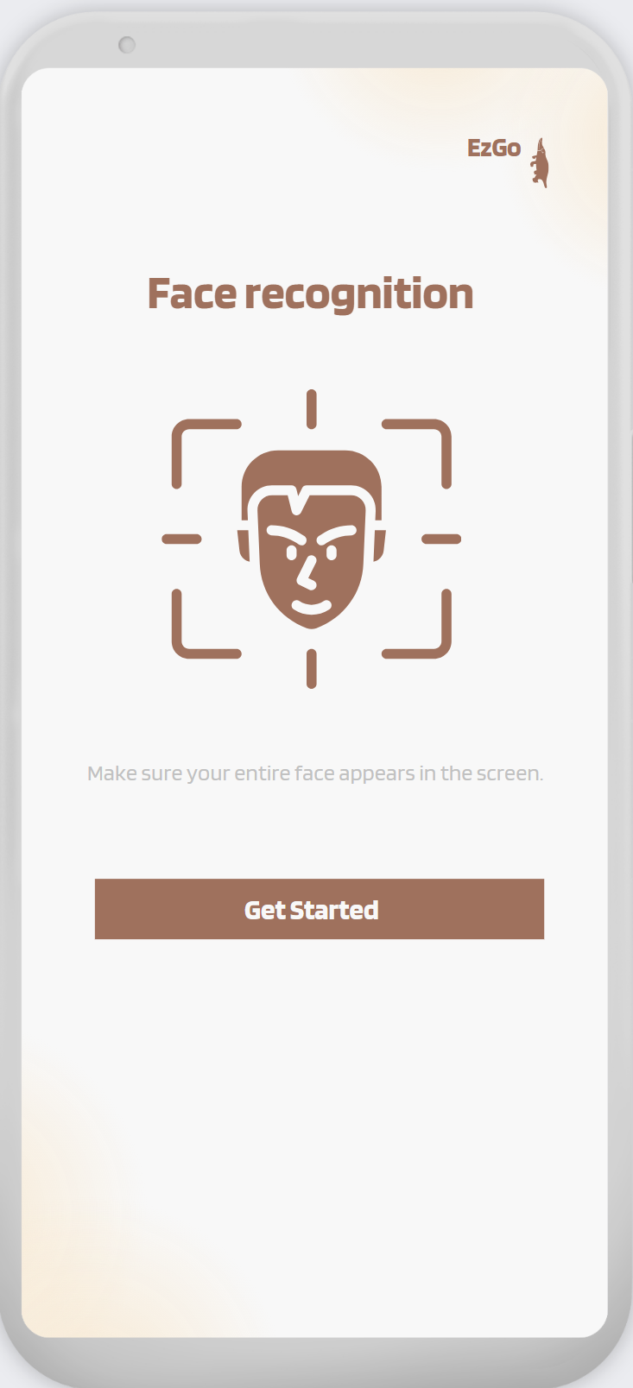
Face
Recognition
End Demo

Slide 6
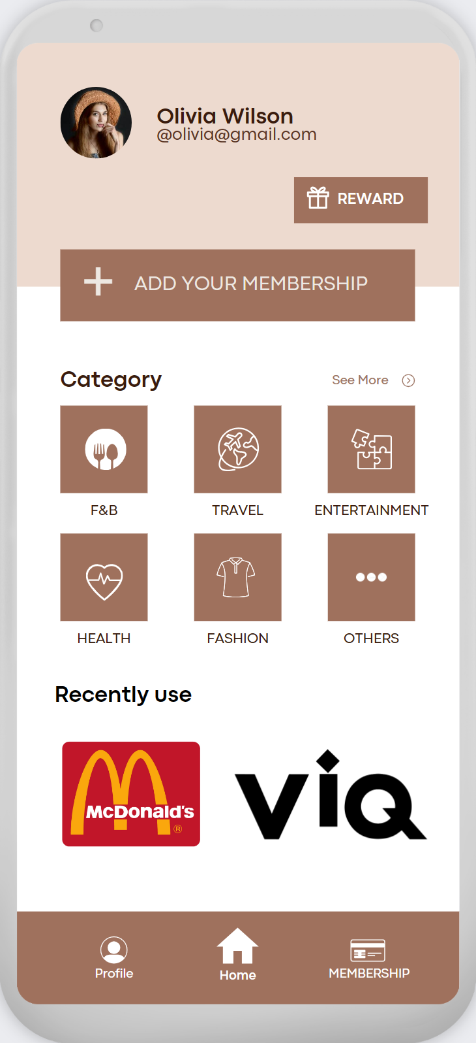
Home Page
End Demo

Slide 7
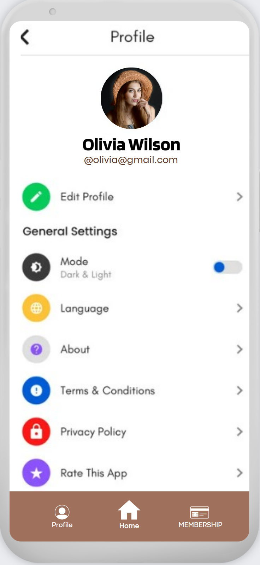
Profile
End Demo

Slide 8
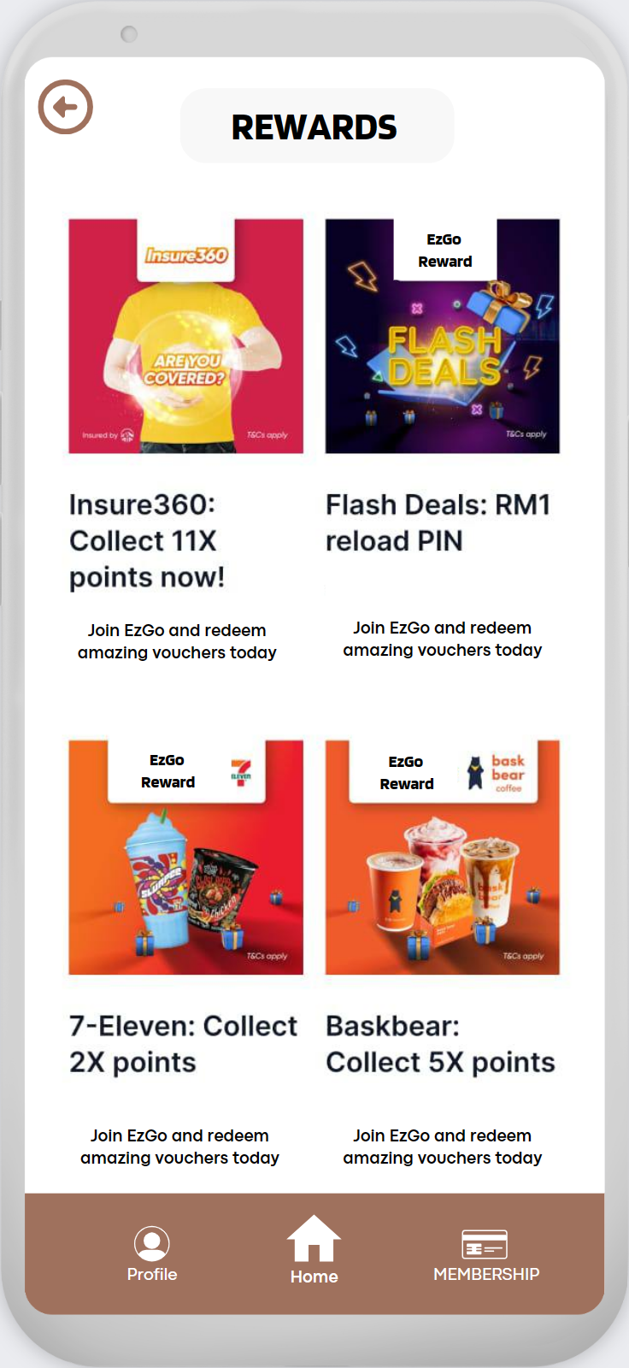
Rewards
End Demo

Slide 9
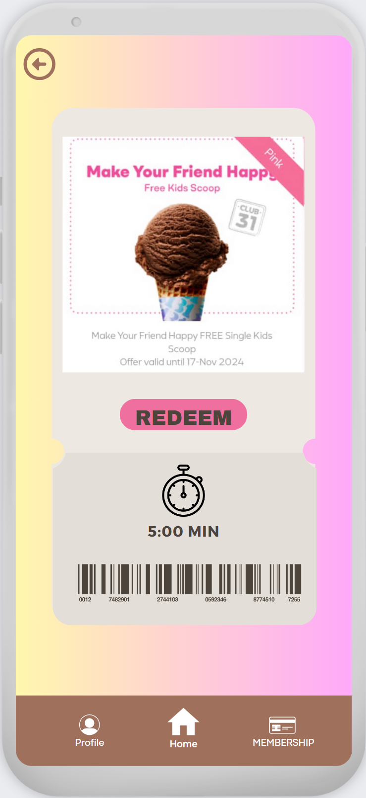
Sample
Reward
End Demo

Slide 10
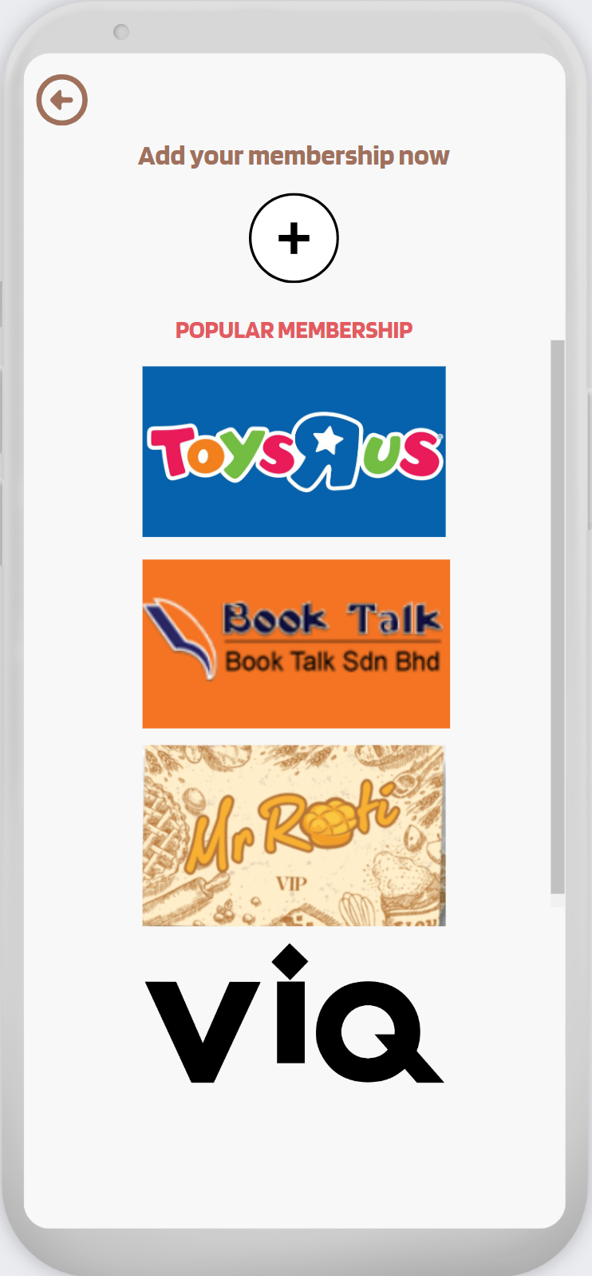
Add new
membership
End Demo

Slide 11
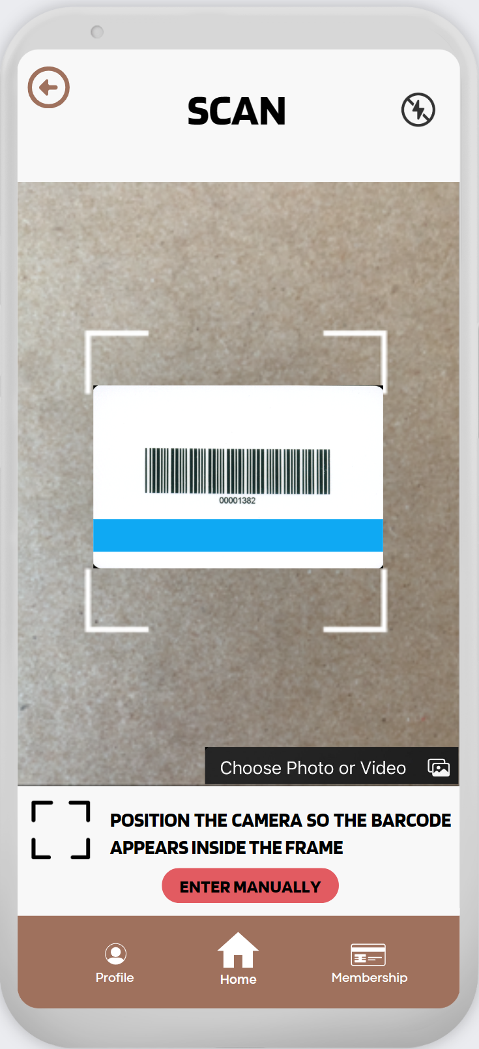
Scan Card
End Demo

Slide 12
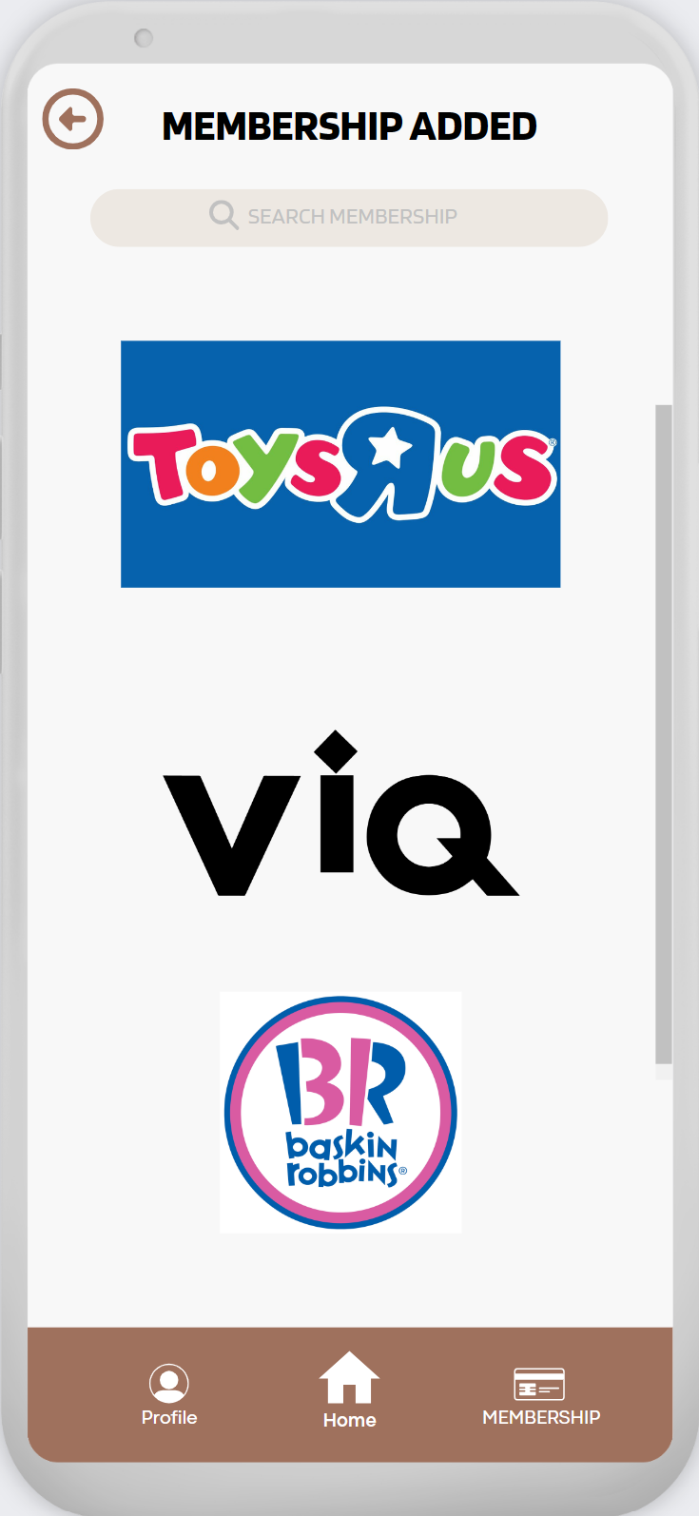
Membership
Added
Click on ViQ to see how
does a membership page
looks like!
End Demo

Slide 13
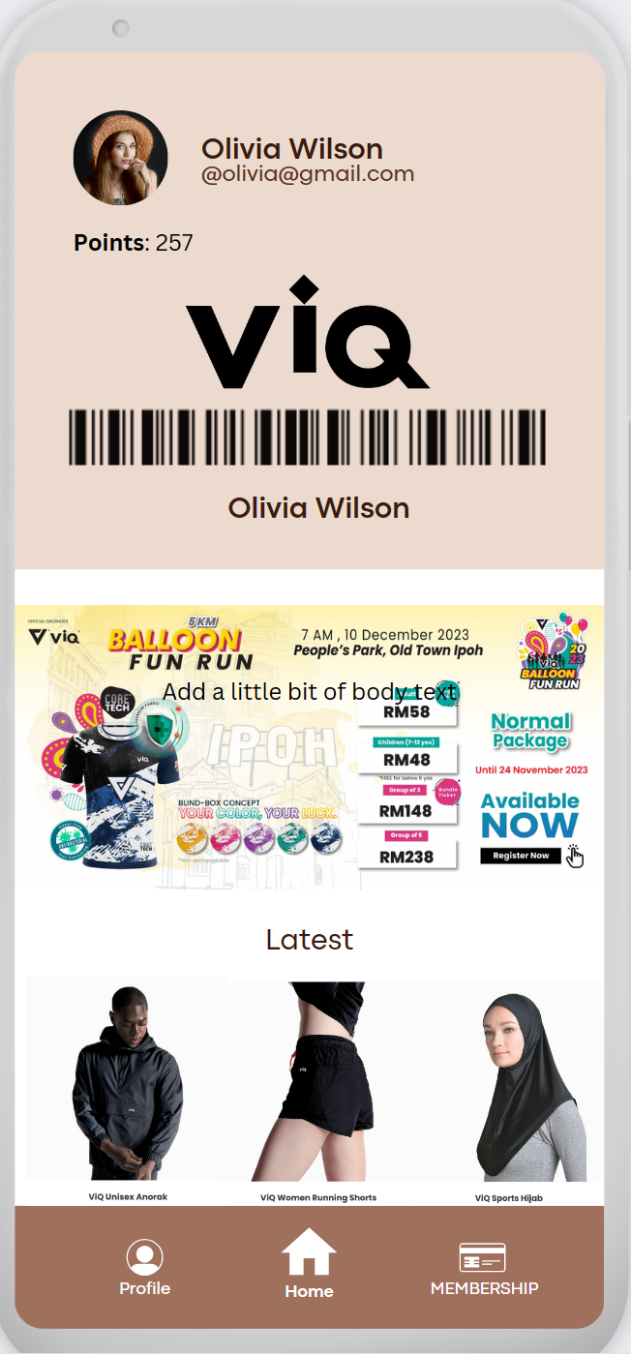
Sample
Membership
End Demo

Slide 14
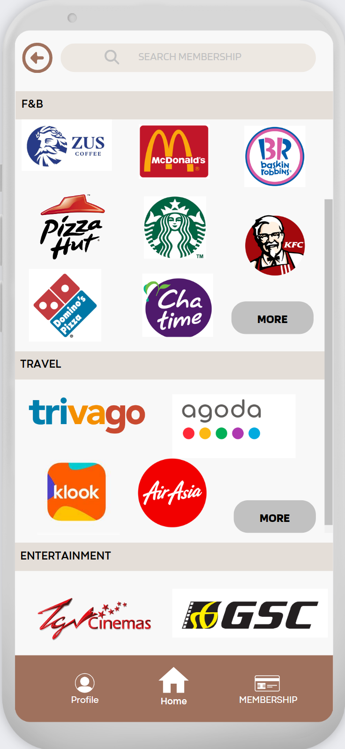
Navigation
Click on McDonalds / Pizza Hut
/ AirAsia to see how
does a membership page
looks like!
End Demo

Slide 15
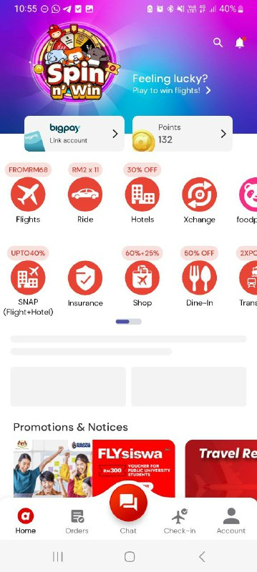

Air Asia
End Demo

Slide 16
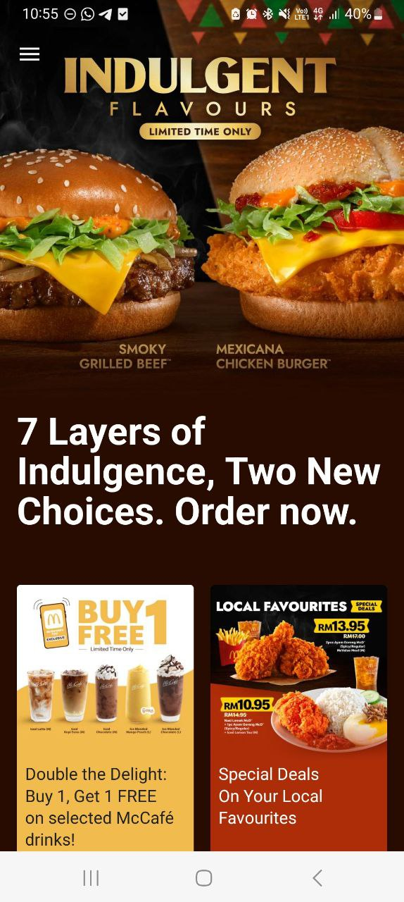
McDonalds
End Demo

Slide 17
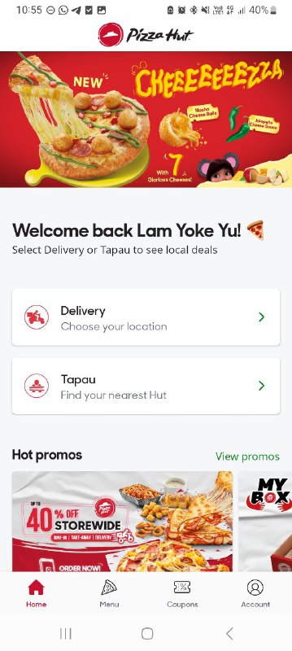
Pizza Hut
End Demo

Slide 18
Thank You

